Slide 1
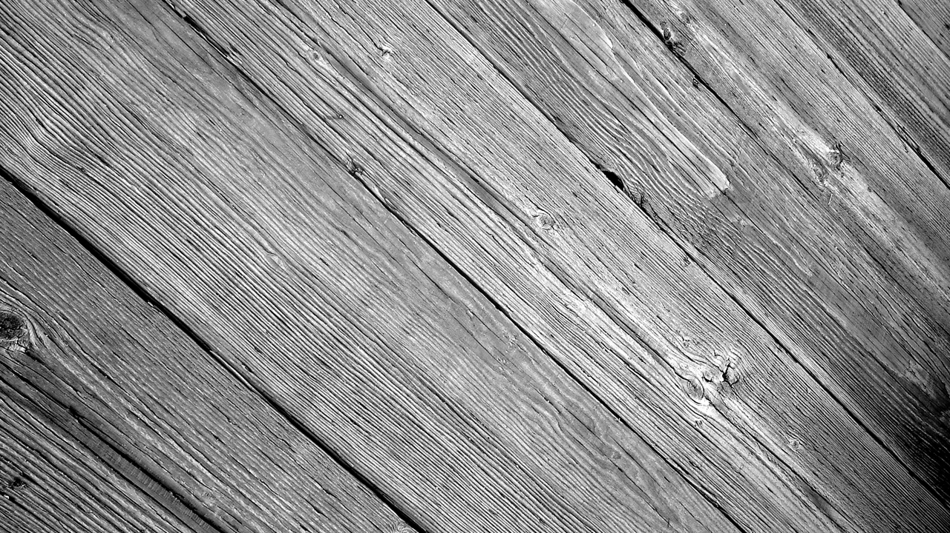
Believe
Week 26

Slide 2
Patience

Slide 3
How would you define patience?

Slide 4
The capacity to accept or tolerate delay, trouble, or suffering without getting angry or upset.

Slide 5
The Ability To Go Through Trials and Troubles… Without Complaining

Slide 6
Think about the following scenario

Slide 7
You have been given the largest account in the office and you are leading a meeting with the president of the account at 8am.
Also, your boss will be at the meeting to evaluate you for a potential promotion.

Slide 8
The alarm did not go off the morning of the meeting and you wake up an hour later than you had planned.

Slide 9
You get dressed and quickly grab a cup of coffee when you find that you spilled coffee on your shirt which has left a large visible stain.
More time lost.
• You get in the car, it will not start, a dead battery.
• More time lost.
• Do you feel the blood pressure rising?
• Finally, you get the car started; now it is a straight shot to work.
• Now you get behind someone who is driving 45 mph on the highway and there is no passing them. The pressure rises.
• Next up, you hit EVERY stoplight on the way, more time lost.
• I know that while all this is going on around us, we are the picture of serenity behind the wheel.

Slide 10
You get in the car, it will not start, you find you have a dead battery.
More time lost.

Slide 11
Do you feel the blood pressure rising?

Slide 12
Finally, you get the car started; and if you drive fast enough you can still make it to the
meeting just a couple minutes late.

Slide 13
Now you get behind someone who is driving 45 mph on the highway and there is no passing them.
The pressure rises.

Slide 14
Next, you hit EVERY stoplight on the way, more time lost.

Slide 15
If this were happening to you, would you be feeling relaxed and patient?

Slide 16
The Negative Consequences
Of Impatience
Run the risk of always being dissatisfied, upset, and angry with ourselves.
Easily lose our control and fire off outbursts of anger, temper, and blame on others.

Slide 17
We become a member of the "throw away" generation, discarding relationships, people, jobs, school, churches etc.
We waste energy worrying about how slow things are changing instead of directing the energy toward the changes we desire.

Slide 18
We withdraw prematurely from a helping situation because we are not seeing an immediate pay off for our efforts.
We sacrifice friendships and relationships prematurely because the other person is not changing as quickly or as thoroughly as we desire.

Slide 19
We ignore all of the positive gains we and others have made along the way and only concentrating on what has not yet been accomplished.
We become pessimistic about life and neglect to count our blessings.

Slide 20
Wanting to see certain results now, we burn ourselves out – and neglect other important things, and become discouraged when the goals are not instantly realized.
We lose the ability to take a large goal and break it down into manageable increments.

Slide 21
We become overwhelmed by the large tasks ahead of us and lose the hope and motivation to keep on trying.
WE FAIL TO TRUST GOD!!!

Slide 22
Do you think we are becoming more patient or less patient as a society?
Why?

Slide 23
We are a people of instant gratification communicating with a God of patience; a people who want immediate results in a relationship with a God who says “Wait – I’ve got this.”

Slide 24
We are a people who focus on the “Now” serving a God focused on the future. We are a people who focus on this life serving a God focused on eternity.

Slide 25
What are the opposites of patience?
Haste
Hurried
Impatient
Stress
Worry
Anxiety

Slide 26
What are signs of impatience?
Irritability
On edge
Stressed-out
Frustration
Tightly wound

Slide 27
What other fruit of the spirit are you lacking when you lack Patience?
Hope

Slide 28
Romans 5: 3-4
…we also glory in our sufferings, because we know that suffering produces perseverance; perseverance, character; and character, hope.

Slide 29
Patience is not in our nature.
Patience is a Spiritual Gift that God develops in us usually by troubles, and delays, and disappointments.

Slide 30
James 1: 2-4
Consider it pure joy, my brothers and sisters, whenever you face trials of many kinds, because you know that
the testing of your faith produces perseverance.

Slide 31
Let perseverance finish its work so that you may be mature and complete, not lacking anything.

Slide 32
Do you really believe Romans 8: 28?

Slide 33
And we know that in all things God works for the good of those who love him, who have been called according to his purpose.

Slide 34
Why is having patience so difficult when we are in pain?

Slide 35
How do you answer the following question: “If God is good and all-powerful, why does he allow his creation to suffer pain?”

Slide 37
“Why does God love us so much that, even though he is all-powerful, He allowed his Son to suffer torment, tremendous pain and death so we may have eternal life?”

Slide 38
1 Peter 2: 19-21
For it is commendable if someone bears up under the pain of unjust suffering because they are conscious of God.

Slide 39
But how is it to your credit if you receive a beating for doing wrong and endure it? But if you suffer for doing good and you endure it, this is commendable before God.

Slide 40
To this you were called, because Christ suffered for you, leaving you an example, that you should follow in his steps.

Slide 41
James 5: 7-8, 10-11
Be patient, then, brothers and sisters, until the Lord’s coming. See how the farmer waits for the land to yield its valuable crop, patiently waiting for the autumn and spring rains.

Slide 42
You too, be patient and stand firm, because the Lord’s coming is near.
Brothers and sisters, as an example of patience in the face of suffering, take the prophets who spoke in the name of the Lord.

Slide 43
As you know, we count as blessed those who have persevered. You have heard of Job’s perseverance and have seen what the Lord finally brought about. The Lord is full of compassion and mercy.

Slide 44
Helpful Tips for Patience
Let God Develop it in you - Allow God to put you through the hard times

Slide 45
Learn to pray through the trials
Psalm 55: 22
Jeremiah 32: 27
Luke 18: 1-8

Slide 46
Thank God for everything
1 Thessalonians 5:18
“give thanks in all circumstances; for this is God’s will for you in Christ Jesus.”

Slide 47
Look Up and Ahead -not back, or down

Slide 48
Hebrews 12: 1-2
Therefore, since we are surrounded by such a great cloud of witnesses, let us throw off everything that hinders and the sin that so easily entangles.

Slide 49
And let us run with perseverance the race marked out for us, fixing our eyes on Jesus, the pioneer and perfecter of faith. For the joy set before him he endured the cross,

Slide 50
scorning its shame, and sat down at the right hand of the throne of God.

Slide 51
Read His Words

Slide 52
Romans 15: 4 (NLT)
Such things were written in the Scriptures long ago to teach us. And the Scriptures give us hope and encouragement as we wait patiently for God's promises to be fulfilled.

Slide 53
Don’t let the stress of this world rob you of your patience.
Patience:
Renews our strength.
Teaches us to trust God
Matures us
Shows the world we are different
God has a perfect plan and purpose in making us wait.

Slide 54
Is it possible to have patience when the situation you are in is full of pain?
Where do we find this patience?

Slide 55
John 15: 5 "I am the vine; you are the branches. If you remain in me and I in you, you will bear much fruit; apart from me you can do nothing.”

Slide 56
Psalm 27: 14
Wait for the Lord;
be strong and take heart
and wait for the Lord.

