Slide 1
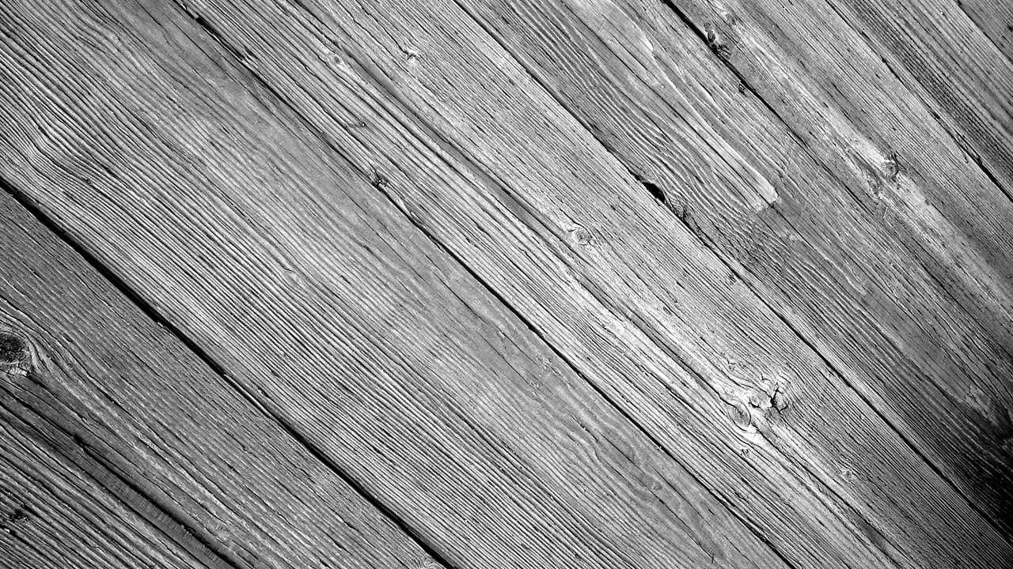
Believe
Week 27

Slide 2
How do you define kindness?

Slide 3
the quality of being friendly, generous, and considerate.
a behavior marked by ethical characteristics, a pleasant disposition, and a concern for others.

Slide 4
The Greek word for “kind” is chrestos.
Part of the meaning includes action.
(1 John 3: 11-18)

Slide 5
Action typically includes some kind of self-sacrifice and therefore generosity on our part, especially of our time

Slide 6
This does not mean that action does not include words. Encouraging words of comfort, courtesy, compliments and even correction can be a heartwarming act of kindness.

Slide 7
Did you know that kindness is not only good for the soul, but it is good for the body as well.

Slide 8
Kindness
Makes us sensitive to another’s needs (James 2: 14-18)

Slide 9
Kindness
Makes us treat everyone the same. The way we want to be treated (James 2: 1-13)

Slide 10
Kindness
Makes us treat others the same way God treats us (Ephesians 4: 31-32)

Slide 11
We must make it our goal and habit to be actively looking for opportunities to show kindness. How do we do this?

Slide 12
Our motives for showing kindness must not be so we can impress people.
(Matthew 6: 1-4)
What word was acts of kindness linked with?

Slide 13
Who does kindness focus our attention on, ourselves or others?
What happens to us when we focus on the needs of others and not ourselves?

Slide 14
What are the first 3 letters the word “kindness” begins with?
Just like the word our kindness should begin with our Kin.

Slide 15
Who are typically the first to see our bad side or who are we most likely to act unkind to?

Slide 16
Who is our Kin?
Matthew 12: 48-50
Hebrews 13: 1
1 Peter 3: 8-9

Slide 17
Are we supposed to show kindness to those who are mistreating us?
Acts 16: 19-33

Slide 18
When her owners realized that their hope of making money was gone, they seized Paul and Silas and dragged them into the marketplace to face the authorities.

Slide 19
They brought them before the magistrates and said, “These men are Jews, and are throwing our city into an uproar by advocating customs unlawful for us Romans to accept or practice.”

Slide 20
The crowd joined in the attack against Paul and Silas, and the magistrates ordered them to be stripped and beaten with rods. After they had been severely flogged, they were thrown into prison, and the jailer was commanded to guard them carefully.

Slide 21
Question:
Who was responsible for carrying out the flogging of prisoners?
The Jailor

Slide 22
When he received these orders, he put them in the inner cell and fastened their feet in the stocks. About midnight Paul and Silas were praying and singing hymns to God, and the other prisoners were listening to them.

Slide 23
Suddenly there was such a violent earthquake that the foundations of the prison were shaken. At once all the prison doors flew open, and everyone’s chains came loose.

Slide 24
The jailer woke up, and when he saw the prison doors open, he drew his sword and was about to kill himself because he thought the prisoners had escaped. But Paul shouted, “Don’t harm yourself! We are all here!”

Slide 25
Questions:
Why was the jailor attempting to kill himself?
If this man had almost beat you to death, would you like to see him dead?

Slide 26
Questions:
What was Paul and Silas demonstrating by not leaving the prison?
Why did they do this?

Slide 27
Luke 23: 34
Jesus said, "Father, forgive them, for they do not know what they are doing."

Slide 28
The jailer called for lights, rushed in and fell trembling before Paul and Silas. He then brought them out and asked, “Sirs, what must I do to be saved?”

Slide 29
They replied, “Believe in the Lord Jesus, and you will be saved—you and your household.” Then they spoke the word of the Lord to him and to all the others in his house.

Slide 30
At that hour of the night the jailer took them and washed their wounds; then immediately he and all his household were baptized.

Slide 31
Question:
Why did the jailer wash their wounds?
He inflicted them!

Slide 32
What was the end result of the kindness shown by Paul and Silas?
he and all his household were baptized.

Slide 33
Is it possible to show kindness to those who are mistreating you?
What is the impact on the one mistreating you when you show them kindness?

Slide 34
Where do we get the power to show kindness when we are being mistreated?

Slide 35
John 15: 5 "I am the vine; you are the branches. If you remain in me and I in you, you will bear much fruit; apart from me you can do nothing.”

Slide 36
Kindness and Goodness is not primarily a matter of what you know, or what you do, but what you are.

Slide 37
Things to Consider
Our kindness ought to mimic God’s.
God’s kindness is patient toward our weaknesses as we strive to overcome them.
God’s kindness does not overlook rebellion.

Slide 38
Does kindness include tolerance of sin?

Slide 39
God is the example of kindness, but in his kindness He does not overlook rebellion. In the same way we ought to be kind, yet our kindness must not compromise God’s truth or the moral purity of His church

Slide 40
Galatians 4: 16
Ephesians 4: 15
Acts 15: 1-2
1 Corinthians 5: 1-7

Slide 41
Repeat after me:
I chose to be kind and good in my relationships with others.

